Slide 1
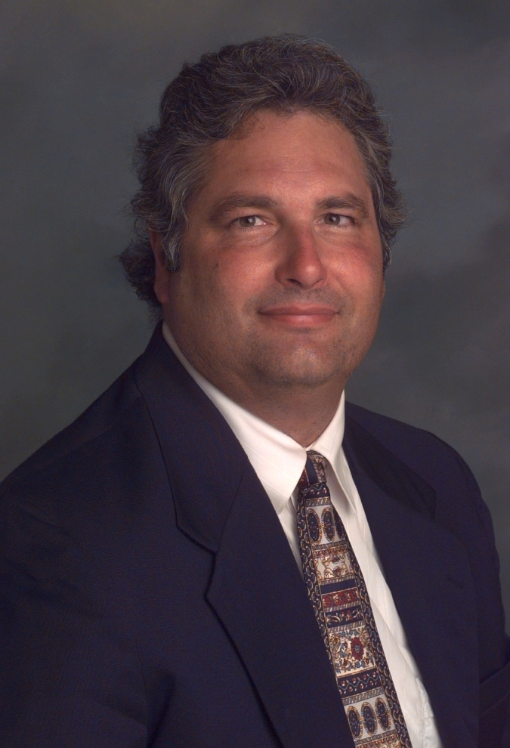
Data Science in L.A.'s “Silicon Beach”: “Shadow” Vocation or “Emergent” Profession?
2015 CSU-POM Conference
CSU Northridge
28 February 2015
Wayne Smith, Ph.D.
Department of Management
CSU Northridge
ws@csun.edu
This PPT is available at: http://smithw.org/csupom.pdf

Slide 2
Motivation
Background/Preliminaries
I apologize…
“cloud computing”, “big data”, “marketing analytics”, and worse of all, “data science”
These are industry “terms”, not ours
I prefer decision-support systems, predictive modeling, statistical computing, and mathematical optimization, but most of the folks I routinely work with prefer the term “data science” (I suppose we might agree on the terms analytics and visualization.)
I am on the steering committee for the LA R/Data science Meetup group
There are a few other Ph.D.s heavily involved too—Szilard Pafka (primary), David McArthur, Rob Gould, Jeremy Miles, Tim Triche, and others
Opportunities and Challenges
Is there a perturbation (disequilibrium) in this labor market?
What should be our institutional role (if any) in this community?
Are we witnessing the emergence of a new data guild in the service economy?

Slide 3
Candidate Explanations
Behavioral Economics
“Extreme Discounting”
Overweighting of short-term preferences and underweighting of long-term goals
Finance
“Loan-to-Value”
“I might not do well, but at least I’m not in debt.”
Educational Psychology
“You don’t know me!”
“UC, CSU, and CCC’s teach mostly theories and I mostly just learn how to write papers there.”
Political Science
“Help! I’m scared and confused!”
“If I don’t take this job, someone with an H1-B visa might.”
Statistics
“As n -> N, I get asymptotically closer to rejecting falsity.”
“If I have more data, then I have proportionally more information.”
Historiography
“Merchant Guilds”
Trades[men] and crafts[men] have always created local, persistent, supportive communities.

Slide 4
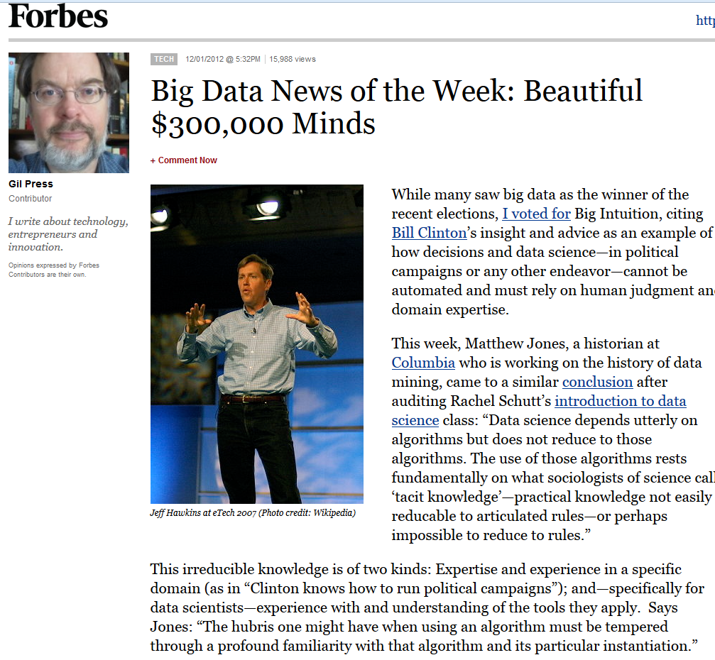

Slide 5
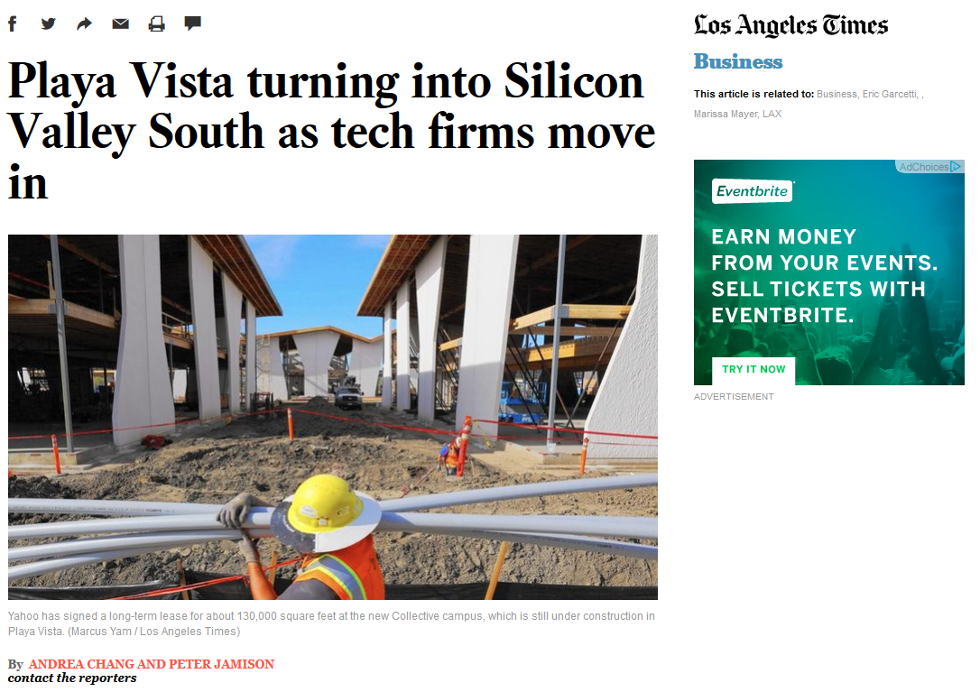
http://www.latimes.com/business/la-fi-silicon-valley-south-20150118-story.html#page=1

Slide 6
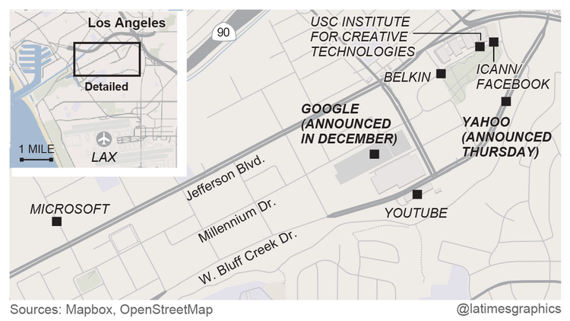

Slide 7
Coordination
Monthly Meetups (physical, not virtual)
E.g., www.datascience.la
Monthly meetings (50-200 people)
By language/platform/environment: R, Python
By technology/workflow: Visualization, DW/BI, Machine Learning
By sector/domain: AdTech, FinTech
By management “level”: a few directors- and mangers-only events (by invitation)
Annual Conferences (physical, not virtual)
E.g., “Big Data camp” at Direct TV (El Segundo)
http://insidebigdata.com/2014/06/03/free-conference-big-data-camp-2014/
Multiple, parallel tracks
Vendor support (all expenses covered fully)
Last three years’ attendance—200 (2013), 500 (2014), 800 expected (2015)

Slide 8
R and/or other tools
COTS (Non-FOSS)
SAS, IBM SPSS, Stata, S-PLUS, BMDP, Lisrel, EQS, HLM, MPLUS, SmartPLS, …
Mathematica, @Risk, Excel add-ins, RATS, Matlab, Simscript, Arena, etc.
IBM Netezza, MS Anal. Srv., Oracle Adv. Anal., Teradata Miner, etc.
UCINET/NVivo/Tropes, ConQuest, ArcGIS, etc.
IBM CPLEX, MOSEK, GUROBI, Frontline, etc.
FOSS/GNU
Domain-specific?
GRETL/xBUGS, Ggobi, Pajek, lisp-stat, Netlib/BLAS/LAPACK/FFTPACK, etc.
Sage, octave, Scilab, Java/Colt/JFreeCharts, incanter, Protovis, D3, etc.
GNU LP, COIN-OR, NASTRAN/BLAS, NETLIB, WordNet, statconn, etc.
General-purpose?
jQuery/jqueryUI/flot/jstat, BIRT, RapidMiner, Pentaho, etc.
Apache Solr/Hadoop/Spark/Lucene/OpenNLP/Mahout/Velocity, etc.
Python ― iPython/NumPy/matplotlib/statmodels/Blaze/Bokeh/scikit-learn, etc.
Julia ― iJulia/Juno/MultivariateStats/MLBase/TimeSeries/Gadfly/JuMP, etc.

Slide 9
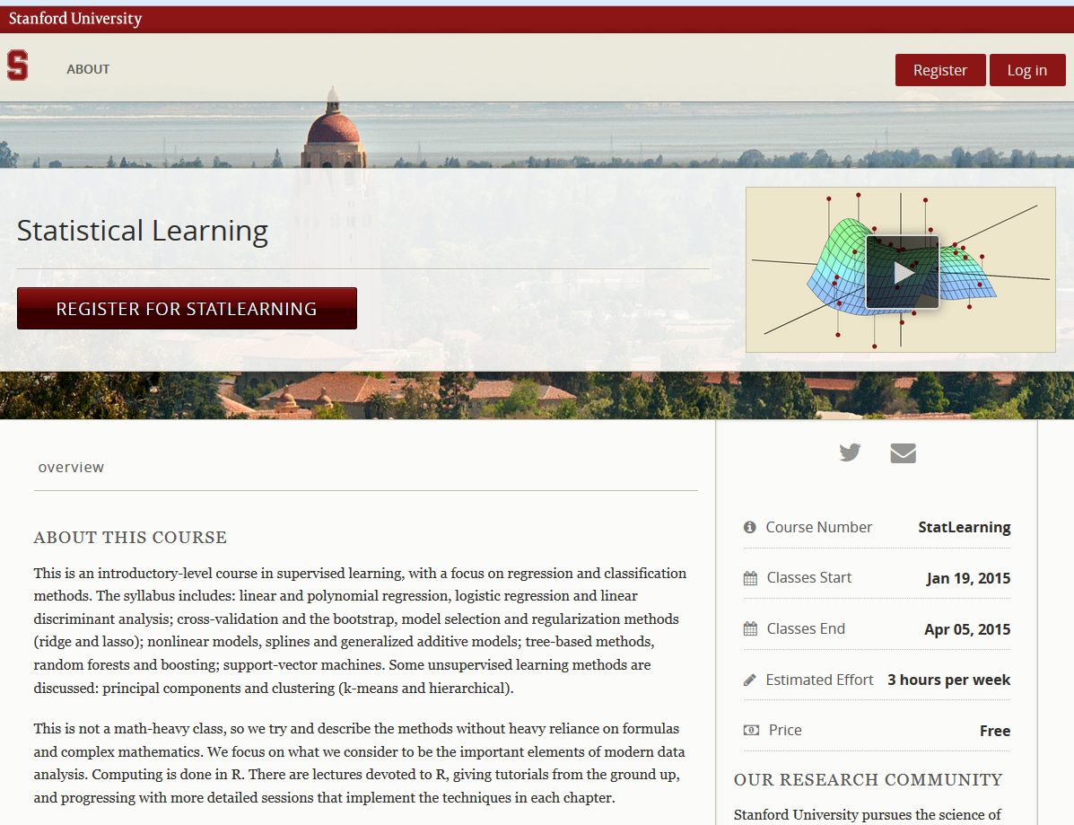

Slide 10
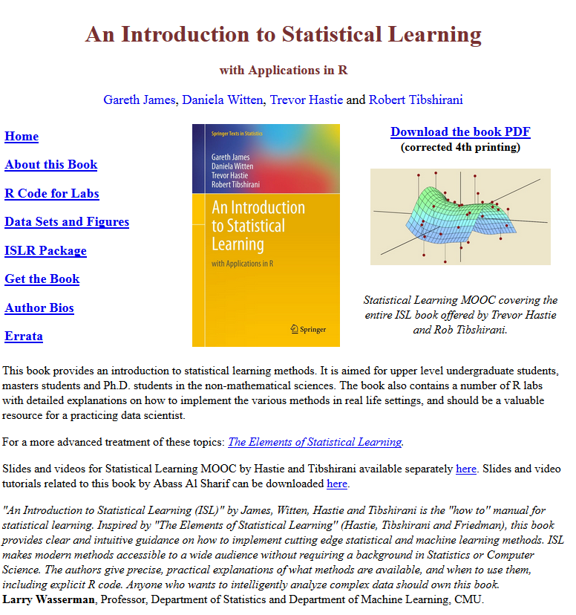

Slide 11
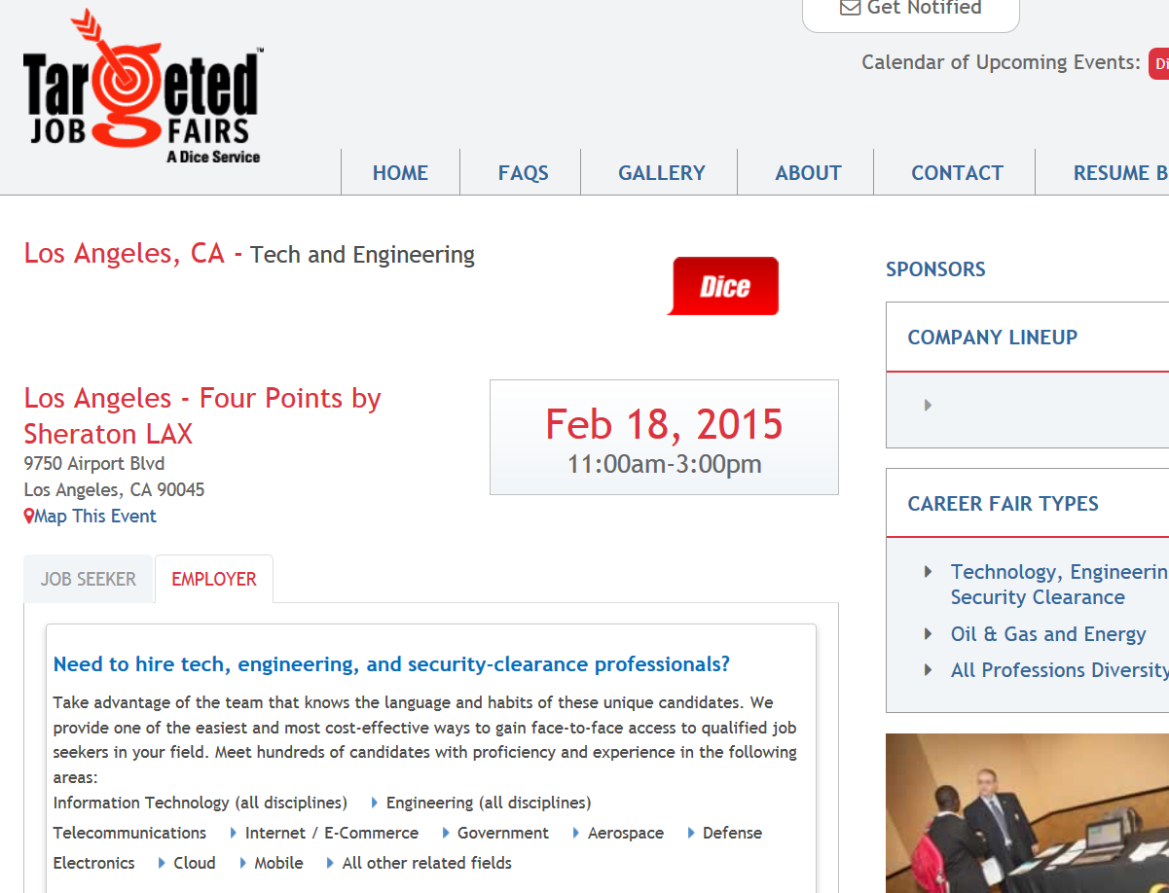

Slide 12
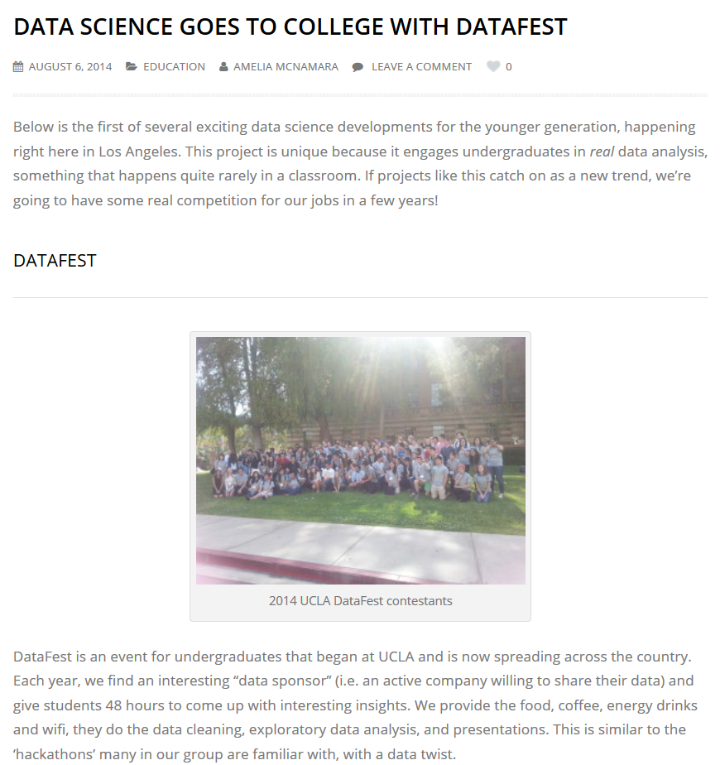

Slide 13
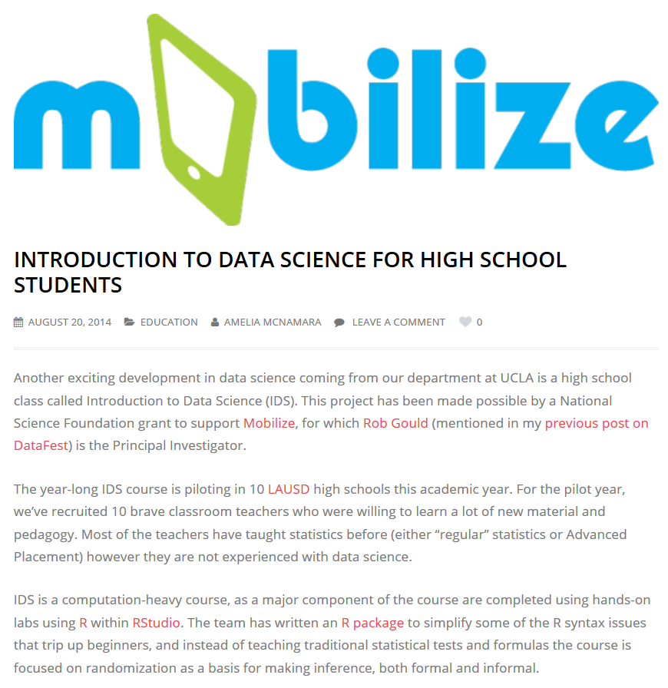

Slide 14
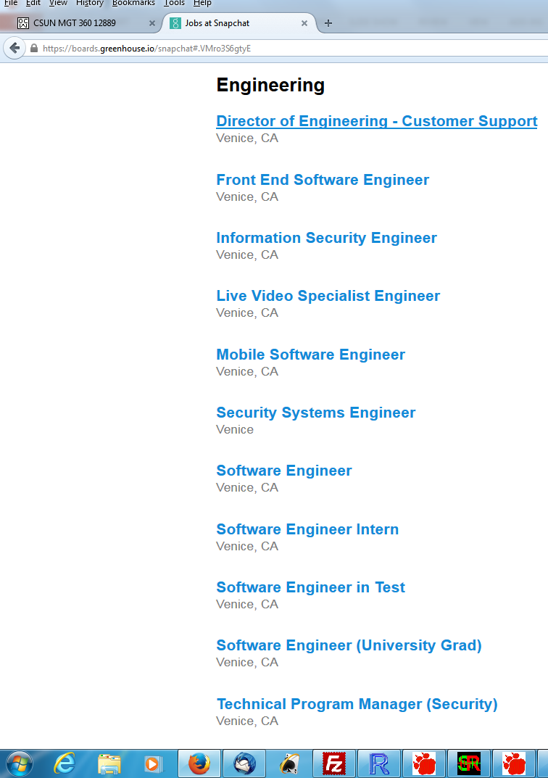

Slide 15
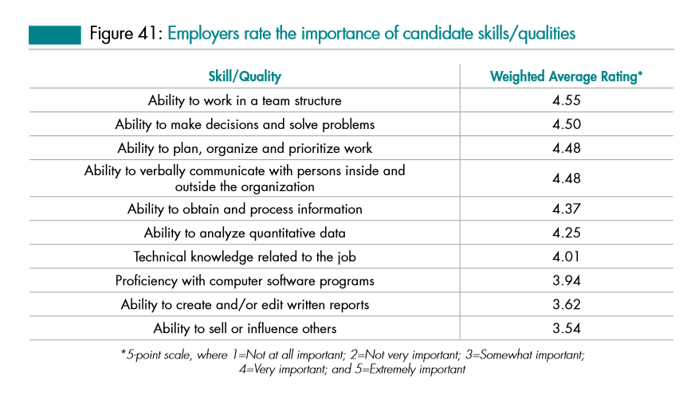
Source: Job Outlook 2014, National Association of College and Employers

Slide 16
The New “Service” Economy in CA?
15 CA Community Colleges will offer Bachelor’s Degrees beginning in 2017.
Airframe manufacturing technology, Antelope Valley College
Industrial automation, Bakersfield College
Emergency services and allied health systems, Crafton Hills College
Mortuary science, Cypress College
Equine industry, Feather River College
Dental hygiene, Foothill College and West Los Angeles College
Bio-manufacturing, Mira Costa College
Respiratory care, Modesto Junior College and Skyline College
Automotive technology, Rio Hondo College
Health information management, Mesa College
Occupational studies, Santa Ana College
Interaction design, Santa Monica College
Health information management, Shasta College

Slide 17
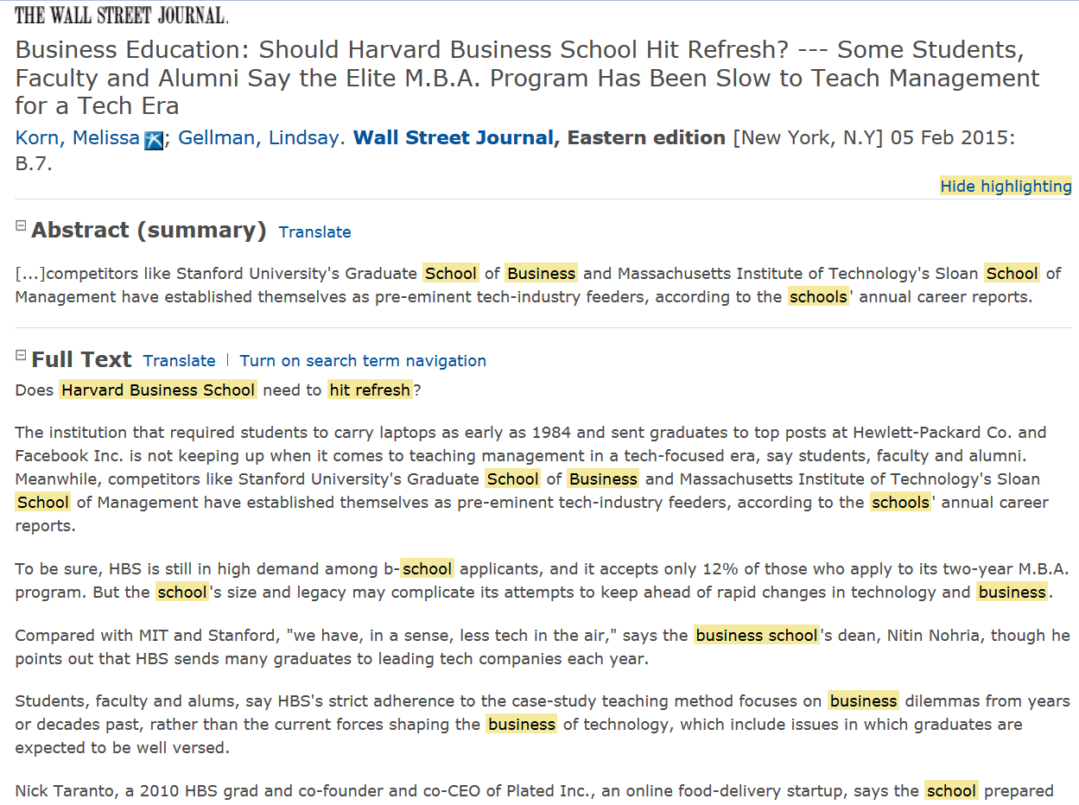

Slide 18
Open Questions
Is this observation an itinerant, ephemeral fad or a persistent structure?
Is this eco-system geographic-specific or due to its virtual nature, widespread?
Vis-à-vis other paid work, is this type of work off-shorable over time?
If this sector is indeed growing, is it still just a small part of the economy anyway?
Is this phenomenon (like some other aspects of IT) gender-skewed?
Does the evidence suggest privileging competencies over degrees?
Is my experience with these “professionals”, ultimately, the triumph of practice over theory (as seen from the perspective of a prospective, potentially confused soon-to-be-in-some-debt-from-a-student-loan CSU student)?

Slide 19
Open Questions
Without college degrees, how will these “data scientists” eventually lead/be ethical/well-rounded, etc. over a 40-year career arc?
Licensing? Certifications? “Badges”?
How will they get promoted?
Can they can just enroll into holistic B.S./B.A. (pre-M.S./M.B.A.) programs later in life?
If applied math, computer science, statistics, and business strategy were all individual degrees before, then how do we make a single “data science” degree (all of them together) now?
What is the role of Ph.D.’s and academics (other than paid consulting)
If we help (e.g., lectures, provide experts, networking, etc.), are we, in fact, directly or inadvertently helping young folks not go to College?
What do we tell our Deans and Provosts about our deep involvement with individuals who aren’t in going to college?
Isn’t this phenomenon, if evident, just a new version of (yet on more) vocation?
And the CA Master Plan, much less the CSU, “educate” individuals (non-professionals) into vocations.
Does any of this matter to our programs in either the short-run or long-run?
Your thoughts?

Slide 20
Further Reading
Los Angeles Economic Development Corporation
High Tech in LA (October, 2014)
http://laedc.org/wp-content/uploads/2014/10/High-Tech-in-LA_20141006_FF.pdf

